Slide 1
Heard Island 2016
DVD By James Brooks ( 9v1yc)
History and Geography of Island
This Slide Slow will Feature :
Logistics, Planning, Complexity, Cost, Sacrifice of
Operators along with Maps, Propagation Paths, past Dxpeditions, the extreme weather, and remoteness of the island such that all can appreciate the difficulty of putting Heard Island on the air.

Slide 2
Heard Island 2016

Slide 3
Heard Island 2016
Overview
14 Operators will land by sea and put 4-6 stations on the air at 2 sites for 3 weeks ( March 18th to April 10th )
Logistical support will be world wide along with top of the line equipment and real time satellite logs ( DXA )
Additional and more detailed information is available on tw0 websites: www.heardisland.org and www.vk0ek.org

Slide 4
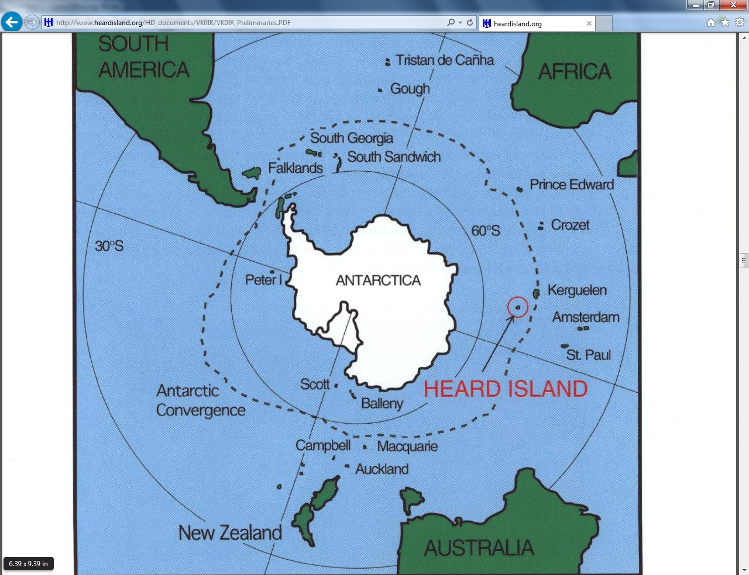
Heard Island 2016
Location of Heard

Slide 5
Heard Island 2016

Slide 6
Heard Island 2016

Slide 7
Heard Island Station Sites

Slide 8
Heard Island Landing Plans

Slide 9
Heard Island – Spit Bay Station

Slide 10
Heard Island – Atlas Cove Station

Slide 11
Heard Island –VK0IR Atlas Cove

Slide 12
Heard Island – VK0EK Quarters

Slide 13
All Past Operations from Heard

Slide 14
Recent Heard Dxpeditions

Slide 15
VK0EK Operating Strategy

Slide 16
VK0EK Band Propagation

Slide 17
VK0EK Propagation
Falling Solar Flux and the decline of cycle 24 could be partially offset by:
Operation will occur during Spring Equinox
Thus higher MUFs, Longer more Band Openings
Higher Signal Strengths
Openings may not be as consistent as on downward side of cycle ( VKOIR ‘97 vs VKOEK in 2016. )
40,30,20 Best Bands, possibly 17M 229 to 40 degrees
Best openings W6/W7 @ Sunset/Sunrise

Slide 18
VK0EK Equipment
Rigs K3
Amplifiers
Yagis for High bands, Phased Verticals Low Bands plus separate antennas for RX
Logging N1MM
DXA Satellite Log Check ( Website Information)

Slide 19
VK0EK Financial Costs
Dxpedition Budget $ 550,000 ( 92% Funded )
Individual Operator Cost: $ 18,000
Dxpedition $20 Million of public Liability Insurance
Largest cost is ship Braveheart $350,000 ( See Website for details )

Slide 20
Heard Island Weather Realities
At 53 Degrees South the climate on Heard is Polar
80% of Island covered in ice (41 glaciers ) and volcanic rock [ last lava flow: 2000]
Wind is constant ( 26 Mph to as high as 110 Mph )
Mix of ice, freezing rain, snow, wind, rain, fog and low clouds.(Basically a Moonscape with Snow 75% of time)
Temps 33 to 40F degrees Summer,30-35 Winter.
Island 150 Miles Square – elevation sea level to 9K feet.

Slide 21
VK0EK Operation Site Comparison
Tromelin Tropical – Landing by airstrip use of existing shelters
Amsterdam landing by boat at existing docks & 40 degrees S. Latitude - use of existing shelters.
Wake K9W Tropical, use of existing facilities and ease of landing.
Seychelles Dxpedition a resort type facility in total.
The recent Chesterfield Dxpedition remotely came close to the conditions the Heard Group will face.

Slide 22
Timetable of VK0EK
Depart from Capetown South Africa March 8th –trip to Heard ( approx. 3000 miles and 6-8 days ) Arrival and operation from Heard March 18th to April 10th. Depart for Fremantle, Australia and arrive April 22nd.
Landing on Heard will be in Zodiacs from Braveheart.
Camp 1 on Atlas Cove set up first, then Spit Bay

Slide 23
Operator Skills and Profiles
The 14 Man operating team is a mix of Businessmen, Scientists, Engineers, Outdoor enthusiasts, and Mountaineers. Many have previous Dxpedition experience. Ages: 49-65
Contesting skills are one of the the most valuable, as basically they are setting up a Multi-Multi type operation.
Their operating time is not a vacation, it’s a JOB !

Slide 24
Demands and Stress for Operators
At sea for approximately a week
Possibly in a seasick state, land in miserable weather and conditions, and assemble your camp/home for the next 3 weeks.
Pileup demands, wind, weather, and related uncertainties.
It takes a person with a special temperament …….
Think of what these men are enduring B4 U complain.

Slide 25
Heard Island 2016
Be Certain you and your station are fully prepared.
This will probably be the last Dxpediton to one of the rarest and most inaccessible parts of the world in our Ham Radio lifetimes due to the tremendous cost and logistics involved.

