Slide 1
Spokane DX Association N3FJP Logging Suite January 7, 2016
By Chris Pritchard
WX7B

Slide 2
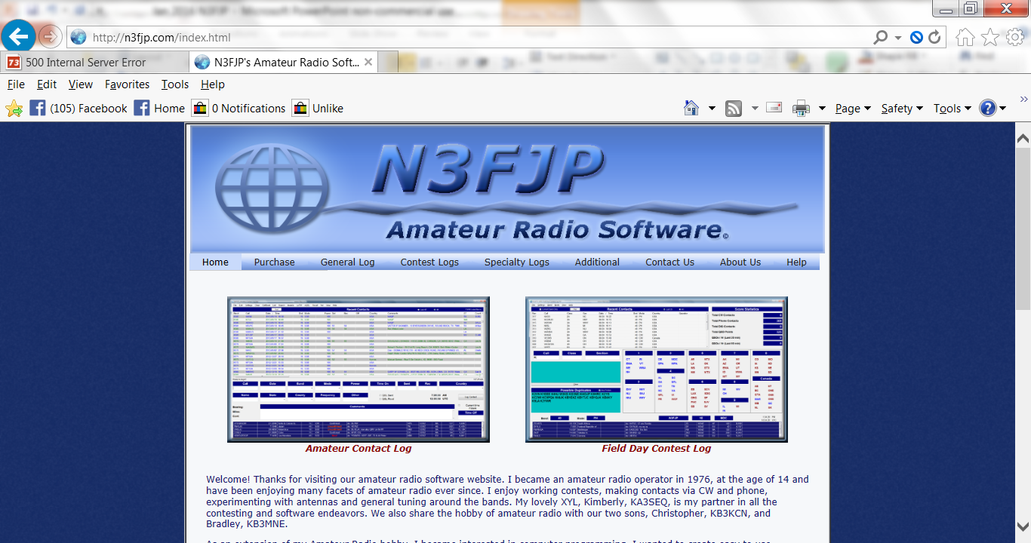
N3FJP Logging Suite http://n3fjp.com/index.html

Slide 3
General Logging Software
“From that first program, our software library has grown to nearly 90 applications! Amateur Contact Log is an easy to use general logging program that has many great features including tracking of worked all states, counties and countries. The rest of our programs are easy to use "contest specific" applications.”

Slide 4
$$$$$ Cost $$$$$
$64.99 N3FJP Software Package & CD
$49.99 N3FJP Software Package without CD
Also, available per individual program

Slide 5
Upgrades, Costs
This package includes full registration of all my amateur radio software, but does not include a CD. Simply download the software programs from this website as needed. This option also includes free registration of any additional amateur radio software that I add to the package, as well as free upgrades to existing programs. There are no annual / maintenance costs of any kind. Simply pay once and you are set with N3FJP Software for life!

Slide 6
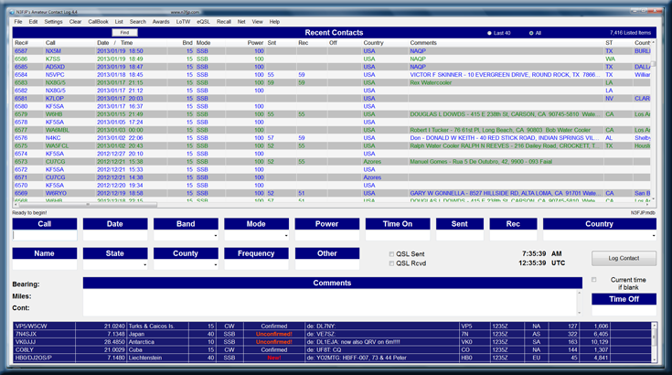
N3FJP General Logging Program

Slide 7
Contest Logging Example CQ WW DX

Slide 8
Resources
How To Configure N3FJP AC Log To Upload Logs To Logbook of The World :
http://www.arrl.org/files/file/LoTW%20Resources/N3FJP.pdf
http://www.eham.net/reviews/detail/1565?page=13
https://groups.yahoo.com/neo/groups/N3FJP_Software_Users/conversations/topics/5

